Slide 1
Anomaly Based Network Intrusion Detection
Olanrewaju Okunlola

Slide 2
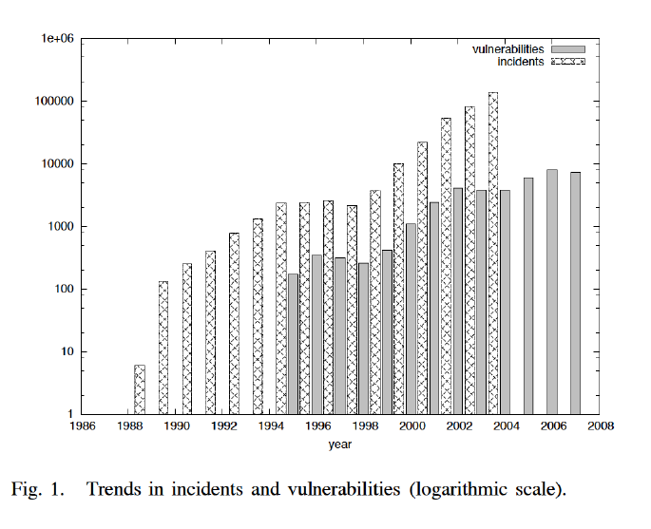
Increased security risks
Today, the number of Internet users is continuously increasing, along with new network services. With each passing day, more and more confidential transactions are carried out via the Internet. As the internet grows, network security attack threats have become more serious.
One recent trend in network security attacks is an increasing number of indirect attacks which influence network traffic negatively, instead of directly entering a system and damaging it.
Even on highly over-provisioned links, malicious traffic causes an increase in the average DNS latency by 230% and an increase in the average web latency by 30% .

Slide 3
What are network anomalies
How it works:
1
The term anomaly-based intrusion detection in networks refers to the problem of finding exceptional patterns in network traffic that do not conform to the expected normal behavior.
2
According to one of the research papers analyzed, Anomaly Detection works on two phases: learning phase and detection phase. In the learning phase, it builds a system profile for the normal system parameters and states. While in the detection phase, the system compares the current system parameters with ones in the stored normal system profile, if they deviate in some way, an alert of intrusion is reported to the administrator or an appropriate action could be taken
There are two broad categories of network anomalies: (a) performance related anomalies and (b) security related anomalies. Security related network anomalies may be due to malicious activity of intruder(s) who intentionally flood the network with unnecessary traffic to hijack the bandwidth so that legitimate users are unable to receive service(s). Some researchers have found three other categories of anomalous traffic: Network Operation Anomalies ( network device outages, configuration changes), Flash Crowd Anomalies ( new software release or new external interest in a website due to some publicity), Network Abuse Anomalies (due to DDoS, Flooding, Scanning attacks)
3

Slide 4
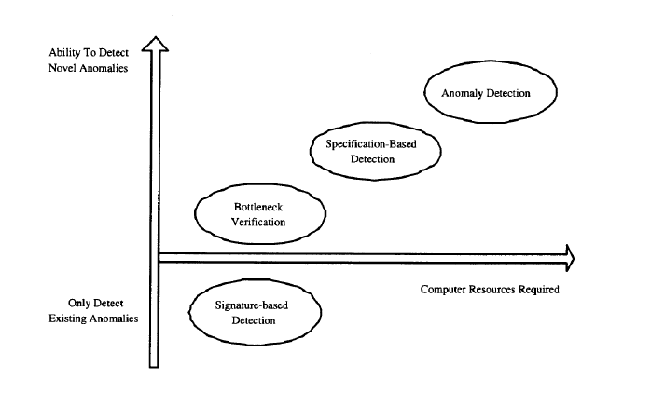
What are network anomalies
How it works:
Different flow-based anomaly detection approaches have been used in the industry to date, these range from:
Threshold based detection (which rely on predefined thresholds for specific measures and are the simplest to use).
Principal component classifiers that defects anomalies in multivariate time series.
Outlier detection algorithms using a sample of normal behavior and calculating deviation from this.
Rule learning algorithms which learn classification rules from training supervised training data.
Of these the hardest to implement are outlier and rule learning
1

Slide 5

Background Research
Over 14 papers were analyzed to determine a way to detect anomalous network patterns
1
One researcher using a Neural Network to allocate a new computational unit whenever an unusual pattern is present in the network
2
Another researcher proposed detecting network attacking using a traffic model with only two parameters: the load of the channel and the number of active flows in it. The researcher noted that these were the best measurements for the current network state.
3
The work by Zhao etc al shows a data streaming algorithm used to filter traffic and identify IPs that show an abnormal number of connections. The researcher uses the scenario of a host having an abnormal number of outgoing connections (large fan out) and the case where a destination has a abnormally large number of incoming connections (large fan in). The first is useful to detect a scanning host while the second is a DDOS victim.
4
The paper by Wang created a detection module called SYN-dog which compares the number of SYN and SYN/ACK packets that a host receives and returns. Under normal conditions the two should be equal but on a system under a SYN attack, many unanswered SYN packets will be sent from a spoofed IP the server cannot respond to, causing a change in the balance of the metric.

Slide 6
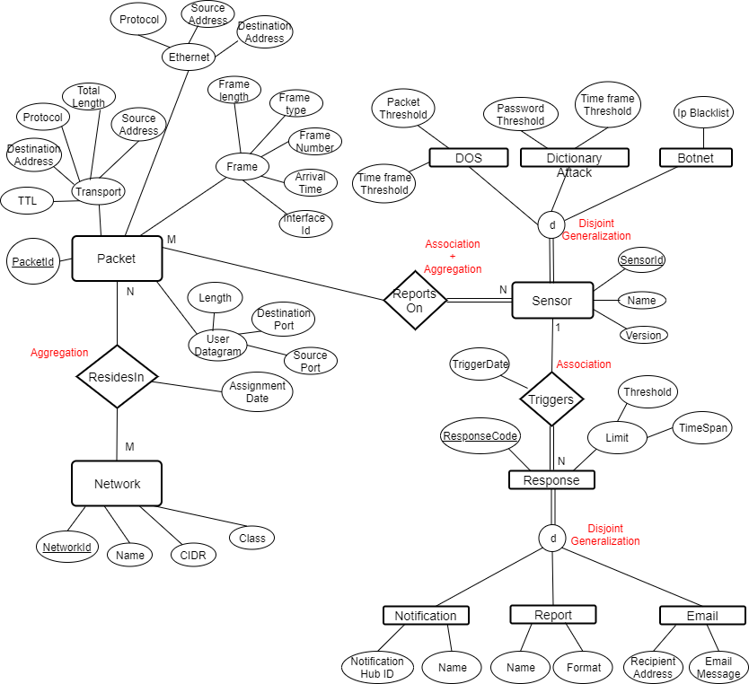
Design
Another paper proposed a system called TOPAS (Traffic Flow and Packet Analysis System) to work as a collector for flow exported by Cisco Netflow or IPFix and provide a framework for user defined detection modules.
We have designed an anomaly detection engine based on outlier and threshold-based algorithms and it represents a hybrid approach using a similar architecture proposed by TOPAS. The first step in this project was the capture network traffic passively at the IP flow level using pyshark
Flows represent a continuous network traffic session and the timestamps do not necessarily indicate the actual beginning and end of a packet stream. They rather depend on the flow expiration and export policy deployed by the monitoring device.

Slide 7
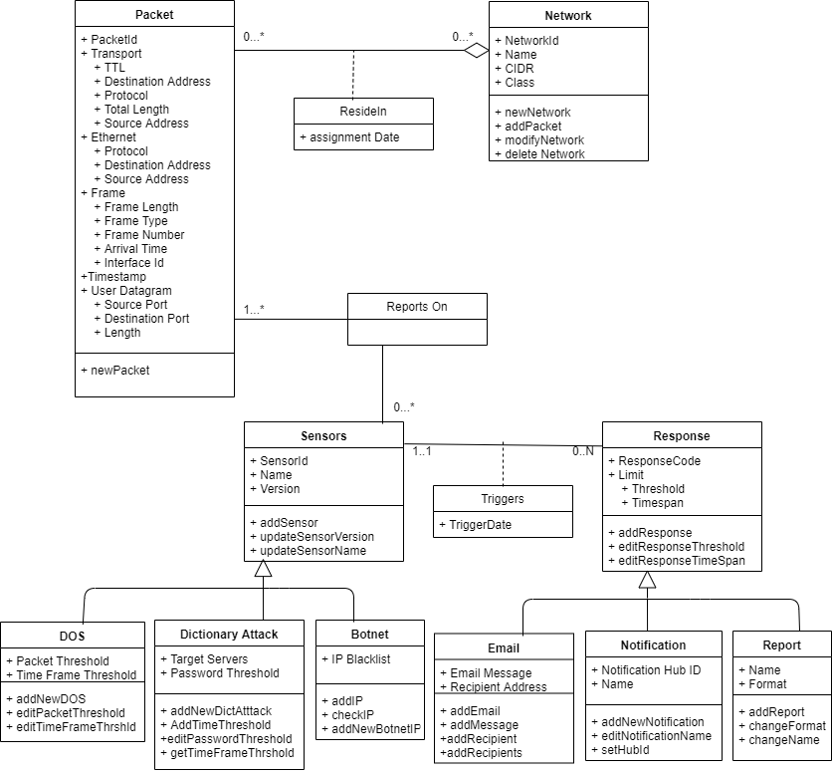
Design
Traffic capture collector which receives and analyzes the raw traffic on the packet and flow level. The received data is stored in a memory buffer and passed to detection sensors.
A set of detection sensors with a matching mechanism for entails looking for patterns of behaviors in the traffic. It listens for new packets from the module manager and process the new flow data from the memory buffer, normalized the data and preprocesses it as required.
A reference data containing thresholds for normal behavior
Alarm component for generating an alarm when a detection is detected

Slide 8

My Approach
1
Perhaps the two most useful suggestions for this report were by Kim etc al who describes various attacks and traffic patterns as well as Navas etc al. Kim describes the following features of packet attacks:
2
Navas realized that signature-based IDS perform poorly at capturing large volume and analysis and that network attack detection could be performed accurately using only statistical methods. They invoked entropy (or Shannon Winer index), which is a mesure of uncertainty or randomness associated with data coming from the network. The more random the data is, the more entropy it contains, where he sample entropy lies between [0, logn]. The rate of entropy hence decreases when the class distribution is more homogenous and increases when it is more heterogenous. For a probability distribution p(X = xi) of a discrete random variable X, the Shannon entropy is defined as:
4
Hence comparing the rate of entropy of some sample of packet header fields to that of another sample of packet header fields provides a mechanism for detecting changes in the randomness. The entropy shows its minimum value 0 when all the items (IP address or port) are same and its maximum value logn when all the items are different.

Slide 9
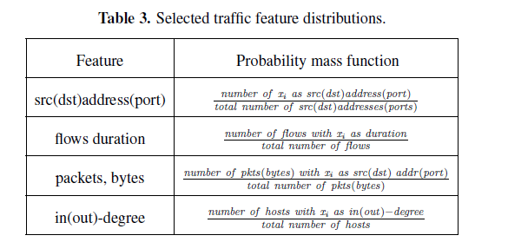
Using Entropy to Measure Normal Behavior
For the purpose of network anomaly detection the paper uses sampled probabilities estimated from a number of occurrences of xi in a time window t are. The following are the network traffic features to be estimated in a time interval. However from the table we will be using only three features
1
The Source and destination address/port: this is the number of times we see in Time window T xi as a source(and destination) address(and port) divided by the total number of source( and destination) addresses (and ports) seen in time window T
2
The number of packets/bytes with IP address xi as the source (and destination) address (and port) in time window T.
3
The in/out degree for hosts in the flow record. For example, for a given host xi, the out-degree is the number of distinct IP addresses the xi contacts and the in-degree is the number of distinct Ip addresses that contacted X.

Slide 10

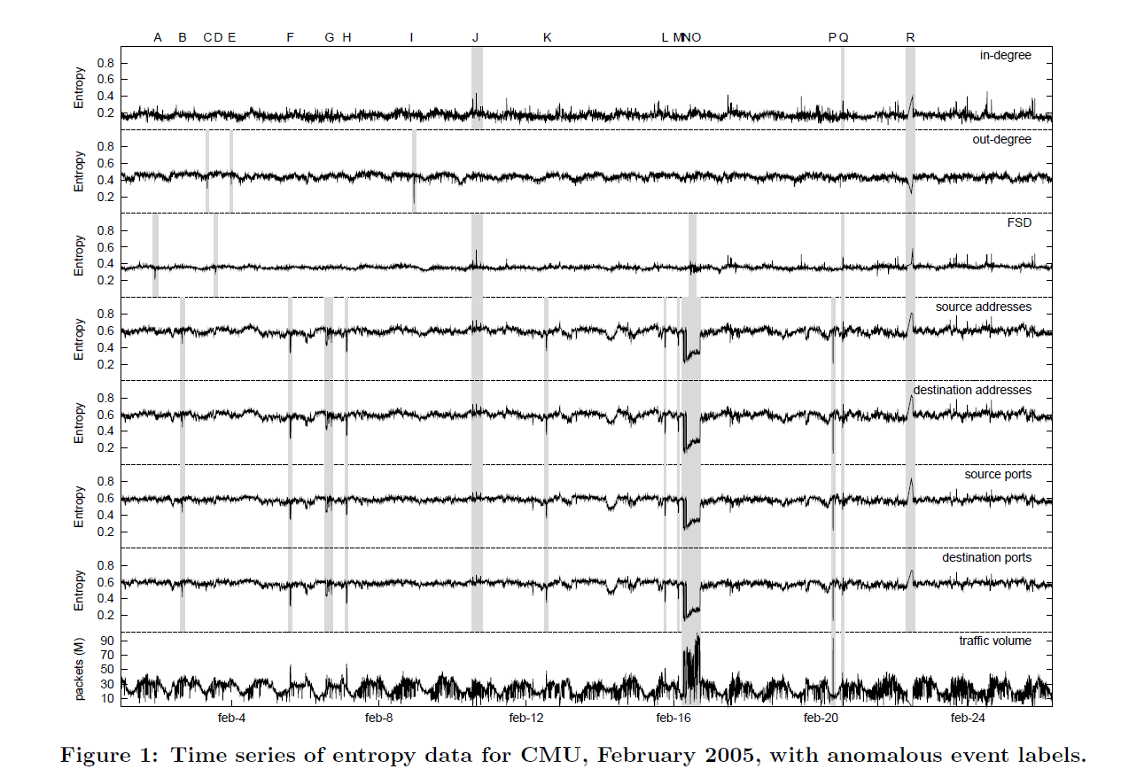

Results from Prior Research
Our final evaluation will raise the traffic as being anomalous if 2 of the three features return a normalized entropy between two-time windows (as measures on a time series) of greater than some threshold defined by the network administrator.
The accuracy of this model for detecting events was measured by a paper from Berezinski etc al.
Results

Slide 11

Questions?
Select the Tell Me what you would like to know about this project.
Notes:
In Slide Show mode, select the arrows to visit links.

